Slide 1




Psychopathology & synthesis
Psychosynthesis & Education Trust
Postgraduate weekend · 11–12 April 2026
Notes:
• Timing — Case work (teaching slides + tasks, venue-dependent): Leah ~40–45 min; Ousmane ~45–50 min + ~12 min lived-experience video (Day 1 PM); Emily ~55 min + ~14 min video (Day 2 AM); Michael segment ~50–55 min after ~10 min video (Day 2 PM); plus breaks and lunch.
• The weekend links diagnostic language with formulation, risk assessment, dissociation, and psychosynthesis concepts used as clinical frameworks rather than as spiritual bypass.
• Cases match the V4 Word handouts in the CASE STUDIES folder (V4-Leah-Shame.docx through V4-Michael-Risk.docx); they are anonymised teaching material, not live records.
• Risk teaching assumes you map decisions to your own agency, NHS interface, and professional indemnity requirements.

Slide 2
Weekend rhythm and time
Saturday and Sunday: 10:00–17:00 (UK), as contracted for this module.
Each day includes about fifteen minutes meditation,
an optional fifteen-minute check-in,
teaching blocks,
a twenty-minute morning break, lunch (often 13:00–14:00), and
a twenty-minute afternoon break.
Notes:
• Timing — Map these intervals onto your cohort paperwork; confirm lunch clock locally (often 13:00–14:00).
• Attention and memory for risk material decline across long unbroken stretches; breaks are part of safe design for trauma and suicide content.
• Net scheduled teaching time is always less than seven hours per day once openings, lunch, and breaks are subtracted.
• The same slide sequence can be split across a live timetable if your venue uses a different lunch placement.

Slide 3
Teaching frame: authority, containment, engagement
Authority: clear contracts, accountable risk questions, and decisions you could defend to a regulator or employer.
Containment: pacing, boundaries on depth, and stabilisation before exploratory work where dissociation or shame dominates.
Engagement: active formulation tasks, uncertainty tolerated, and reasoning made visible rather than impressionistic.
Notes:
• Timing — Early Day 1: keep this framing compact so Leah (40–45 min including tasks) still fits before the morning break.
• ACE here names the holding structure for postgraduate clinical training, not a separate therapy model.
• Containment overlaps with psychosynthesis emphasis on relationship and sequence before interpretation.
• Engagement matches ACE-Cases design: each vignette ends in formulation, immediate decision, and longer-term or supervision reflection.

Slide 4
Postgraduate learning posture
You bring substantial prior professional and life experience; the standard is formation, not introductory recall.
Clinical judgement means reasons tied to observations, questions asked, and record entries—not preference without evidence.
Pairs and small discussion translate theory into decisions you might make under your contract and supervision arrangement.
Notes:
• Timing — Still Day 1 AM: if you are past ~45 minutes from day start and still in pre-Leah material, shorten discussion to protect the Leah window.
• Transferable skills from healthcare, education, or justice settings alter what feels familiar but not what counts as proportionate risk action in counselling.
• Documentation habits from other roles need aligning with counselling confidentiality and data protection.
• Personal mental health disclosure is never required for participation.

Slide 5
Diagnosis and formulation
Diagnosis functions as a working hypothesis: a shorthand for clustering symptoms and functioning, open to revision as context emerges.
Formulation is evolving and contextual: it links history, relationships, culture, environment, and risk in a narrative you update in supervision.
Neither replaces the other; both can sit in the same file if the reasoning for each is explicit.
Notes:
• Timing — Day 1 AM: diagnosis versus formulation feeds directly into Leah; allow a few minutes for questions before the case title slide.
• NHS and third-sector services often require diagnostic codes for access; that administrative fact does not make the code the whole person.
• A strong formulation states what would falsify it—for example new risk information or a change in housing or employment.
• Trainees sometimes over-weight diagnosis when GP letters are the only collateral; formulation corrects that bias.

Slide 6
Day one — opening
Meditation of about fifteen minutes follows PET convention for starting teaching days.
Optional check-in of about fifteen minutes: “How do you feel about this material?”
Then move into the day one morning block: framing, risk principles, and the Leah case.
Notes:
• Timing — Day 1: allow roughly 15 minutes meditation plus up to 15 minutes check-in before the slides that follow.
• Brief contemplative openings are common before psychologically dense material and may lower physiological arousal for some participants.
• Check-in remains bounded; disclosure of personal mental health history is not a requirement for learning.
• The morning block stacks formulation, shame, and passive risk before neurodiversity and overload in the afternoon.

Slide 7
Day one — morning
Framing, diagnosis and formulation, risk principles, case Leah (shame, family, ND tension, risk).
Psychosynthesis links: parts, meaning alongside risk, brief I–Self and disidentification.
Ends at the morning break before the neurodiversity and Ousmane block.
Notes:
• Timing — Day 1 AM segment: you are heading toward Leah; budget ~40–45 minutes for the full Leah sequence (slides + both task slides + exercise) before the twenty-minute morning break.
• Morning material stacks shame, family expectation, and passive risk before the neurodiversity afternoon so trainees feel why formulation cannot be purely categorical.
• Leah’s GP letter and voluntary-sector setting mirror common low-intensity entry points where risk is under-reported in referral text.

Slide 8
Framing the work
Psychopathology offers shared language across professions and services when that language is used descriptively rather than as identity.
Meaning and risk are held together: one does not cancel assessment, and assessment does not cancel curiosity about what the client cares about.
Uncertainty is ordinary; paralysis and premature closure are both clinical errors in different directions.
Notes:
• Shared language with GPs and psychiatrists reduces collision between medication, talking therapies, and social care when risk is in play.
• Psychosynthesis does not require abandoning DSM or ICD categories; it asks how identification with labels is managed in the relationship.

Slide 9
Working with psychopathology
Diagnostic labels describe patterns, not the whole person; clients arrive already shaped by prior assessments and by what families believe those labels mean.
Your formulation integrates symptoms, history, culture, and environment and can change when new information appears.
Thinking clinically means holding categories lightly enough to notice what does not fit, without denying real impairment or risk.
Notes:
• Collateral from CAMHS, CMHT, or occupational health creates expectation effects; the client may defend or resist a label for good reasons.
• Formulation should name maintaining factors outside the skin: housing, work conditions, caring load, discrimination.

Slide 10
Risk — core principles
Risk is dynamic: it shifts with isolation, sleep loss, humiliation, substance use, and relationship rupture, not only with expressed emotion.
Intensity of affect is not a one-to-one map to level of danger; quiet compliance can accompany high-lethality planning.
Direct, respectful enquiry about thoughts, intent, plan, means, and protective factors is standard practice, not an escalation in itself.
Risk is not held alone: supervision and service structures are part of clinical containment.
Notes:
• Passive ideation and fleeting intent occupy a wide grey band; documentation should capture verbatim phrases and your clinical reasoning.
• Protective factors (children, values, fear of pain) lower but do not remove risk; they belong in formulation and in safety planning.
• When self-report shifts between contacts, risk review frequency increases rather than decreases.

Slide 11

break — 20 minutes
Notes:
• Timing — Morning break: 20 minutes; confirm return time before Day 1 PM (Ousmane + lived-experience video ~12 min after Working practically).
• Cognitive-load theory supports recovery intervals before complex decision tasks such as safeguarding escalation choices.

Slide 12
Case Study: "Leah"
Notes:
• Timing — Leah (Day 1 AM): 40–45 minutes total for all Leah slides including both task slides and paired or small-group work.
• Full narrative and tasks: V4-Leah-Shame.docx in the CASE STUDIES folder.
• The following slides summarise for teaching; the Word handout is the shared reference for trainees.
• Foci: shame, family pressure, tentative neurodiversity themes, shifting risk disclosure, early pacing.

Slide 13
Leah — presentation and context
She has left several retail and hospitality jobs within weeks; busy environments, shift changes, and managerial check-ins overwhelm her.
She withdraws to her room, reverses sleep, drops contact with friends, and describes low energy, self-criticism, and post-social rumination.
A friend raised autism or ADHD; she recognises overload and burnout but refuses assessment, fearing a label would end hope of being “normal.”
Curiosity in the room meets shame and pride; exploration stays descriptive and co-created, not diagnostic.
Notes:
• Timing — Within Leah block: roughly half the Leah window often goes to narrative slides; reserve the remainder for tasks.
• Sensory and executive strain can present as “failure to cope” in workplaces that assume uniform tolerance for noise and unpredictability.
• Refusing assessment can protect identity while also delaying adjustments that might reduce collapse; both sides belong in formulation.

Slide 14
Leah — risk, family pressure, therapy ambivalence
Session two: she denies self-harm; session three after a fight she discloses standing at paracetamol and ibuprofen, wanting everything to stop, then walking away.
She cannot say how long she stood there or whether she handled packets; affect flattens when pressed; she minimises and has not told the GP.
Her mother threatened to stop non-essential spending if she does not find stable work by spring; Leah reads that as conditional love.
Part of her wants honesty and structure; part expects to drop therapy as she dropped jobs; there is no out-of-hours crisis cover in this service.
You must decide in-session whether same-day GP contact is proportionate or whether that risks betrayal and dropout with risk still unassessed elsewhere.
Notes:
• Timing — Within Leah block: if you are past ~25 minutes from the Leah title slide, move soon to Tasks — Leah.
• Shifting self-report across sessions is data: it may reflect shame, cognitive avoidance, or genuine impulse fluctuation.
• Family financial threats raise exploitation and emotional safety dynamics alongside suicide risk.
• Voluntary-sector contracts often lack medical backup; GP liaison is frequently the available NHS interface.

Slide 15
Sub-personalities and shame (Leah)
Different parts may hold contradictory positions: one ashamed and hiding risk, one hopeful about therapy, one hostile to parents, one fearful of labels.
Mapping those positions without dramatising can reduce fusion with any single story the client tells in one hour.
Shame often attaches to help-seeking and to risk disclosure; the part that minimises may be trying to preserve dignity.
Notes:
• Assagioli’s subpersonality language translates to common therapy phrases: inner critic, compliant child, angry adolescent.
• Parts work is not a substitute for risk questions; it follows or runs parallel to safeguarding clarity.

Slide 16
Meaning alongside risk
Suffering can be meaningful in the client’s life story without minimising danger or delaying safety steps.
Non-identification supports witnessing patterns without the therapist fusing with rescue fantasies or with contempt for the client.
Risk decisions remain ordinary, accountable, and documented; meaning-making does not replace them.
Notes:
• Firman and Gila’s material on identification helps explain over-responsibility in therapists when clients express passive ideation.
• Nelson’s integration theme cautions against romanticising breakdown; the ethical bar stays at safeguarding and consent.

Slide 17
I, Self, and disidentification
An observing stance—naming affect and impulse without fusing with them—supports disidentification in session.
Clinical use includes not over-identifying with the client’s narrative or with your own anxiety about getting risk wrong.
Depth and spirit in psychosynthesis still sit inside boundaries, competence, and the duty of care.
Notes:
• Disidentification is practised in small steps: grounding, sentence stems, timeline work—not instant transpersonal claims.
• Therapist countertransference when parents are cast as cruel may obscure the client’s mixed loyalty and dependency.

Slide 18
Psychosynthesis perspective (integration)
Distress may reflect fragmentation of subpersonalities; integration is gradual and relationship-dependent.
Containment precedes exploration when shame, risk, or dissociation are live.
Context and inner process are both in the formulation; neither cancels safeguarding or NHS pathways.
Notes:
• Integration language does not promise linear recovery; it describes direction of travel under supervision.
• Firman and Gila’s attention to context supports environmental adjustment as ethical practice, previewing the afternoon block.

Slide 19
Tasks — Leah (1)
Formulation under uncertainty: draft a working formulation that holds mood, shame, family context, possible ND-relevant processing differences, and risk—stating explicitly what you do not know and what would change your view.
Immediate clinical decision: what do you do after the cupboard disclosure (same day / before next session)—including whether to involve GP, breach confidentiality to parents, or use another route—and why?
If key information appears to be missing, make reasonable clinical assumptions and proceed.
Work with incomplete and contradictory information.
Notes:
• Timing — Leah tasks: allow roughly 20–25 minutes for pair/small-group work on both task slides combined if you are near the 40–45 minute Leah budget.
• Cupboard disclosure without clear intent or plan still warrants updated risk formulation and often GP awareness when medication access is salient.
• Breaching confidentiality to parents risks shame and dropout; withholding may leave domestic risk unmanaged.
• Same-day decisions should be recorded with alternatives considered and reasons for the path chosen.

Slide 20
Tasks — Leah (2)
Longer-term plan and/or supervision reflection: outline how you would pace the next six to eight sessions if she remains engaged, and name one question you would take to supervision about either risk or family/system pressure.
Work with incomplete and contradictory information.
Notes:
• Timing — End of Leah block: brief plenary or move straight to morning break if time is tight.
• Pacing balances shame-sensitive exploration with repeated risk review when self-report shifts.
• Supervision might examine countertransference toward punitive-sounding parents versus realistic safeguarding concerns.

Slide 21

Lunch — 1 hour
Notes:
• Timing — Lunch: 60 minutes; confirm start and end times locally (often 13:00–14:00).
• Post-prandial dips in vigilance are common; risk-heavy material scheduled immediately after lunch may warrant slower pacing.

Slide 22
Day one — afternoon
Neurodiversity, executive load, masking, environment, case Ousmane (overload, children, services).
Practical stabilisation before depth; bifocal vision in tasks.
This block in the file precedes the lunch slide; align to your Saturday clock if needed.
Notes:
• Timing — Day 1 PM (before lunch in this file): neurodiversity teaching, Ousmane case and tasks (pair/plenary ~5 min tighter than v4.4 to absorb video), then lived-experience video ~12 min after Working practically; net block similar to prior if discussion stays disciplined.
• Afternoon material connects nervous-system load with housing, schooling, and welfare interfaces common in UK practice.
• Ousmane’s contradictions train documentation when self-report shifts between contacts.

Slide 23
Neurodiversity — clinical view
Neurodiversity frames difference in processing; impairment is often interaction between person and environment.
Executive functions—planning, inhibition, working memory—explain organisation and timing problems without moral blame.
Sensory overload drives shutdown; masking consumes resources and delays recognition, especially where social expectation is high.
Notes:
• NICE and NHS services may use diagnostic thresholds for ADHD and autism that lag behind self-identification or community language.
• Workplace and education adjustments are legal and clinical levers, not “special treatment” in a pejorative sense.

Slide 24
Masking and the cost of compensation
Camouflaging effort in work, parenting, or study leads to exhaustion, late collapse, and misrecognition by brief contacts.
Clients may present as capable in structured appointments while function at home disintegrates.
Formulation should name the price of passing as neurotypical when demand exceeds capacity.
Notes:
• Burnout after years of masking is often misread as depression without context; history and environment correct that error.
• Shame intensifies when failure is attributed to character rather than to load and mismatch.

Slide 25
Environment × person
Adjusting context—timing, reminders, sensory load, paperwork support—is part of ethical practice, not a lowering of standards.
When the environment changes, the same person may function markedly differently; formulation updates accordingly.
Liaison with housing, school, or benefits may be as important as insight-oriented work in some weeks.
Notes:
• Psychosynthesis bifocal vision holds realistic limits and environmental strain alongside meaning and dignity.
• Single-parent poverty tightens the margin for error when executive load is high.

Slide 26
Clinical challenges (neurodiversity)
Difference is frequently misread as poor motivation or non-compliance in services built on uniform expectations.
Shame accumulates through repeated failure narratives from employers, schools, and prior clinicians.
Your stance needs flexibility without pretending certainty where assessment and support are still pending.
Notes:
• GPs under time pressure may offer minimal intervention; ADHD waiting lists can exceed twelve months in many areas.
• Safeguarding language can be triggered when schools perceive neglect; formulation must separate poverty and overload from intent to harm.

Slide 27
Case Study: "Ousmane"
Notes:
• Timing — Ousmane (Day 1 PM): ~45–50 minutes for case slides, both task slides, and exercise time (~5 min less discussion than v4.4); lived-experience video ~12 min follows Working practically.
• Full narrative and tasks: V4-Ousmane-Overload.docx in the CASE STUDIES folder.
• Foci: executive overload, parenting, safeguarding edge, contradictory presentation, systems interfaces.
• NHS and school pathways constrain what one counselling hour can shift.

Slide 28
Ousmane — overload and contradiction
Executive load: mind goes blank on multi-step tasks, unopened post, phone menus lost once anxiety rises.
Sleep is poor; some days he cannot start meals or wash uniforms despite love for his children and fear of judgement.
Possible ADHD was noted before; assessment never completed after long waits and a dropped triage call.
Between-session texts may sound desperate while sessions sound minimised; channel use may fall outside your service policy.
Notes:
• Contradiction between capable presentation and functional collapse is common in masking and overload, not proof of manipulation.
• Text contact raises boundary and clinical-record questions; agencies differ on whether SMS constitutes part of the record.

Slide 29
Ousmane — ethics, services, shifting account
Autonomy and trust versus duty to children: early school involvement may protect or may drive him away from all support.
NHS ADHD waits and unaffordable private assessment limit biological framing even when it would help self-understanding.
GP contact was superficial; mindfulness advice did not address housing or parenting load.
He reports takeaways four nights one week, then “mostly proper meals” the next and cannot align details.
You choose without unanimity or full information: safeguarding conversation, GP re-referral, stabilisation contract, or another proportionate step—and you record the shifting history.
Notes:
• Children’s services thresholds vary; school concern letters often precede formal section 17 or section 47 processes in England and Wales contexts.
• Documentation of contradictory accounts protects you later if risk is retrospectively questioned.

Slide 30
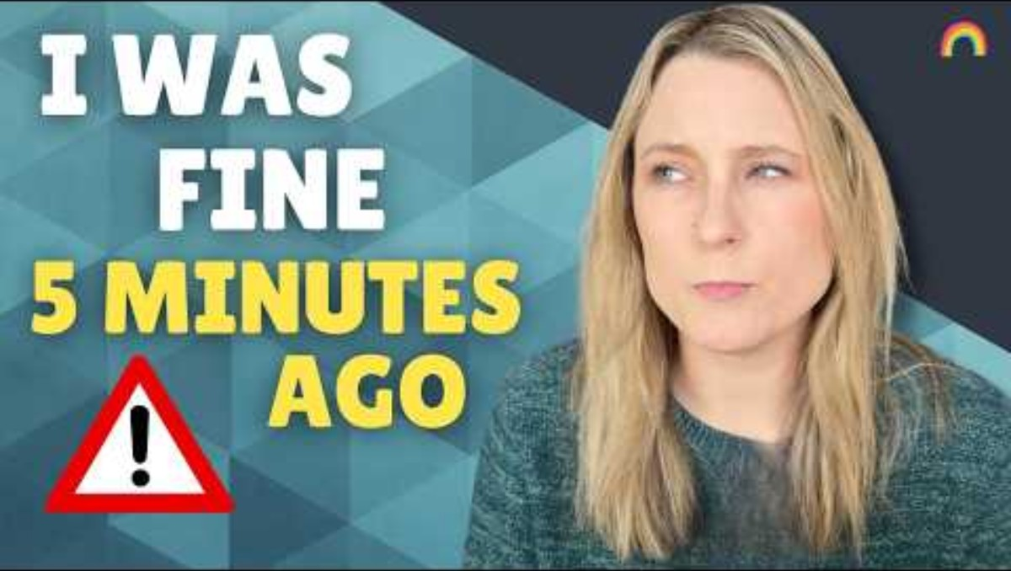
Neurodiversity Video: Autistic Meltdowns, Shutdowns, & Burnouts: What's the difference?
Notes:
YouTube: Autistic Meltdowns, Shutdowns, & Burnouts: What's the difference? https://www.youtube.com/watch?v=tqF92K-G2VM&t=1s
Notice the difference between meltdown, shutdown, and burnout — not interchangeable clinically
Track the internal experience vs outward presentation (especially “quiet” distress)
Hold in mind for Ousmane: functioning ≠ capacity

Slide 31
Tasks — Ousmane (1)
Formulation under uncertainty: integrate neurodiversity-related and executive-load factors with poverty, parenting load, shame, and service thresholds—stating what remains unknown.
Immediate clinical decision: what is your next move after this session (for example consent for school liaison, GP letter, safeguarding discussion, safety plan only)—with brief rationale and what would make you revise it.
If key information appears to be missing, make reasonable clinical assumptions and proceed.
Work with incomplete and contradictory information.
Notes:
• Timing — Ousmane tasks: ~18–22 minutes pair/small-group work across both task slides (slightly compressed to fund the later ~12 min video block).
• Formulation first clarifies hypotheses about overload versus neglect versus both; without it, liaison can be reactive.
• Immediate decisions often hinge on whether children are currently safe enough for brief delay while engagement is secured.
• Supervision questions later may target bifocal vision when every systemic door feels closed.

Slide 32
Tasks — Ousmane (2)
Longer-term plan and/or supervision reflection: sketch a six-session arc balancing practical stabilisation with emotional work, and name one supervision question on safeguarding boundaries or bifocal vision under extreme strain.
Work with incomplete and contradictory information.
Notes:
• Six-session arcs in overloaded parents often alternate practical wins with shame processing; depth without basics usually fails.
• Supervision might examine whether fear of statutory services is distorting your threshold upward or downward.

Slide 33
Working practically
Use structure, routine, written prompts, and graded tasks where they reduce executive demand.
Reduce overwhelm before pushing insight; stabilisation supports later meaning-making.
Referral and advocacy—housing, benefits, school—may sit alongside counselling within role boundaries.
Notes:
• Timing — End of Day 1 PM synthesis: ~2–3 min consolidation; next slide is lived-experience video (~12 min total) before lunch.
• Small repeatable changes track with neuroplasticity themes on day two: repetition shapes habit more than single insights.
• Contracts should name how out-of-session contact is used so crisis texts are clinically intentional.

Slide 34
DAY TWO:
Psychopathology & synthesis
Psychosynthesis & Education Trust
Postgraduate weekend · 11–12 April 2026
Notes:
• Timing — Case work (teaching slides + tasks, venue-dependent): Leah ~40–45 min; Ousmane ~45–50 min + ~12 min lived-experience video (Day 1 PM); Emily ~55 min + ~14 min video (Day 2 AM); Michael segment ~50–55 min after ~10 min video (Day 2 PM); plus breaks and lunch.
• The weekend links diagnostic language with formulation, risk assessment, dissociation, and psychosynthesis concepts used as clinical frameworks rather than as spiritual bypass.
• Cases match the V4 Word handouts in the CASE STUDIES folder (V4-Leah-Shame.docx through V4-Michael-Risk.docx); they are anonymised teaching material, not live records.
• Risk teaching assumes you map decisions to your own agency, NHS interface, and professional indemnity requirements.

Slide 35
Day two — opening
Meditation of about fifteen minutes.
Check-in of about fifteen minutes: “What did yesterday bring up for you?”
Then day two morning: trauma, differential with ADHD, dissociation, Emily, lived-experience recording on dissociation, neuroplasticity, clinical response.
Notes:
• Timing — Day 2 start: ~15 minutes meditation plus ~15 minutes check-in before trauma and Emily material.
• Sleep disruption after emotionally loaded training is a common group phenomenon and does not by itself indicate disorder.
• Today’s dissociation and escalation teaching assumes yesterday’s shame and risk material is already integrated cognitively.

Slide 36
Day two — morning
Trauma physiology, trauma versus ADHD overlap, dissociation, Emily case, neuroplasticity, phased response.
Ends at afternoon break before Michael and integration themes.
Notes:
• Timing — Day 2 AM (before afternoon break): trauma/dissociation teaching, Emily case + tasks (~5 min tighter discussion than v4.4), lived-experience video ~14 min before neuroplasticity, then neuroplasticity and clinical response.
• Dissociation teaching follows trauma framing because defensive absence is easier to understand once nervous-system threat is named.
• Emily’s university context adds institutional confidentiality pressure distinct from NHS services.

Slide 37
Trauma — core understanding
Trauma is held in the nervous system as well as in narrative memory; body responses can precede words.
Regulation, perception, and relating change after threat; triggers can flip states quickly.
Clients may oscillate between hyperarousal and shutdown; both carry relational and risk implications.
Notes:
• PTSD and complex trauma formulations in ICD-11 and DSM-5 still leave grey overlap with anxiety and mood disorders in routine practice.
• Therapist pacing regulates arousal in the hour; faster is not always deeper.

Slide 38
Trauma presentation and ADHD — overlap
Inattention, restlessness, sleep disruption, and emotional lability appear in both trauma-related states and ADHD.
Premature single explanations waste time; formulation holds both until history, onset, and response to stabilisation clarify the picture.
NHS ADHD assessments are often lengthy; trauma-informed stabilisation can run in parallel without closing either hypothesis.
Notes:
• Childhood adversity rates are elevated in ADHD cohorts; correlation does not tell you which to treat first in an adult.
• Medication decisions belong to psychiatry; counselling formulation still informs what to monitor and report back with consent.

Slide 39
break — 20 minutes
Notes:
• Timing — Morning break: 20 minutes; confirm return time before Day 1 PM (Ousmane + lived-experience video ~12 min after Working practically).
• Cognitive-load theory supports recovery intervals before complex decision tasks such as safeguarding escalation choices.

Slide 40
Dissociation
Dissociation is often protective after overwhelm; it may show as spacing out, depersonalisation, gaps in time, or inconsistent recall.
Subtle dissociation is easy to miss in brief contacts; risk assessment degrades when continuity of self is unstable.
Strong dissociation correlates with higher risk when intent and behaviour are not fully accessible to conscious report.
Notes:
• DSM dissociative disorders are under-diagnosed; subthreshold dissociation still matters for safety planning.
• Differentiate ordinary distraction from dissociative absence when self-harm or suicide content is present.

Slide 41
Containment before exploration
Rapid depth or transpersonal interpretation is unsafe when fragmentation and risk are active.
Stabilisation means relationship reliability, predictable structure, and skills for grounding before trauma narrative work.
Spiritual emergency literature describes crisis states; it is background reading, not a technique checklist for beginners.
Notes:
• Grof and Clarke volumes inform understanding of psychosis and spirituality interfaces; they do not replace safeguarding law or competence limits.
• Nelson’s integration theme warns against forcing insight before the client can stay present.

Slide 42
Case Study: "Emily"
Notes:
• Timing — Emily (Day 2 AM): ~55 minutes for case slides, both task slides, and exercise time (discussion ~5 min compressed); then lived-experience video ~14 min before neuroplasticity.
• Full narrative and tasks: V4-Emily-Dissociation.docx in the CASE STUDIES folder.
• Foci: dissociation, inconsistent self-harm reporting, university policy tension, escalation under unreliable data.
• Do not infer trauma history that is not in the written handout.

Slide 43
Lunch — 1 hour
Notes:
• Timing — Lunch: 60 minutes; confirm start and end times locally (often 13:00–14:00).
• Post-prandial dips in vigilance are common; risk-heavy material scheduled immediately after lunch may warrant slower pacing.

Slide 44
Neuroplasticity
Repeated experience strengthens neural and emotional patterns—for better and for worse.
Trauma-linked survival responses become automatic; change tends to be gradual and non-linear.
Insight alone rarely shifts embodied habits without repeated relational and behavioural practice.
Notes:
• Timing — Neuroplasticity follows Emily + dissociation video; ~10–12 min for this and clinical response combined keeps the afternoon break and Michael block on schedule.
• This supports realistic homework and between-session structure rather than single breakthrough expectations.
• Medication and neurodiversity both modulate plasticity; formulation stays multimodal.

Slide 45
Clinical response
Stabilise before exploratory trauma processing when dissociation or risk is active.
Pace the hour to prevent dysregulation; fewer interpretations when arousal is high.
Risk monitoring continues after clients feel safer because new material often emerges with reduced guarding.
Notes:
• Timing — Day 2 AM closure: this slide bridges into the twenty-minute afternoon break before Michael and integration.
• Collaborative safety planning names triggers, early signs, and help-seeking routes appropriate to your service hours.
• Step-down and step-up of frequency should follow risk and functioning, not habit alone.

Slide 46
Day two — afternoon
Risk under ambiguity (Michael)
documentation
supervision
.
Notes:
• Timing — Day 2 PM: ~10 min lived-experience video before Michael; then ~50–55 min for Michael case, tasks, hold uncertainty while acting, supervision, integration (Risk decisions discussion ~5 min tighter than v4.4).
• Private-sector and stepped-care gaps change what “escalation” means but not documentation standards.

Slide 47
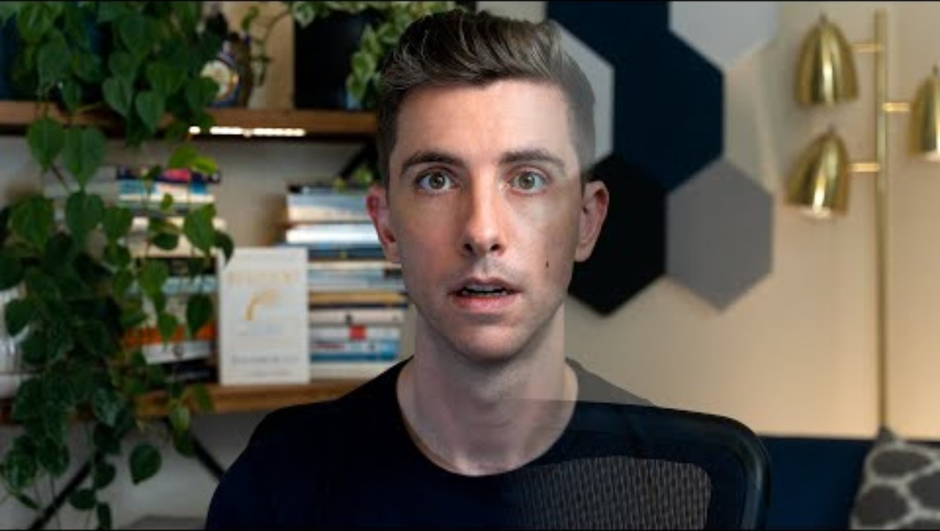
Dissociation Video
Notes:
YouTube: https://www.youtube.com/watch?v=kGlQ_ePWw28&t=1s
Listen for how dissociation affects memory, continuity, and self-report reliability
Note the range from everyday zoning out → clinical fragmentation
Link to Emily: risk assessment becomes less reliable when continuity breaks

Slide 48
Case Study: 'Emily'
— mood, dissociation, inconsistent account
Self-harm reportedly “weeks ago” in session one; by session three she cannot tell cutting three days ago from ideation only.
Healed marks on her forearm are shown; she links them to probable dissociation but cannot sequence events.
Detachment episodes last minutes to hours; after one she missed counselling entirely and lost the afternoon.
Sensory disconnection examples include hearing a phone without linking it to herself.
Notes:
• Inconsistent timelines are clinically meaningful: they may reflect shame, memory fragmentation, or both.
• Do not infer a specific trauma history that she has not given; stay with presented material.

Slide 49
Emily — risk, services, escalation dilemma
She is unsure she can stay safe; she fears psychiatric assessment, compulsory leave, or being seen as manipulative.
Family values stoicism; disclosure to them is partial. A flat email arrives asking to cancel the next session while saying she is “okay now.”
No GP collateral. Local crisis services often gate on explicit intent or recent attempt; her presentation is partial and fluctuating.
The tutor emailed asking if she is “engaging”; you have not answered. Escalation might save life or destroy alliance; non-escalation might hide risk.
Notes:
• University counselling sits inside student conduct and safeguarding policies that differ by institution; you need your own service manual.
• Flat affect in written communication after dissociation reports is not reassurance; it is ambiguous data.

Slide 50
Emily — stabilisation examples (illustrative)
Stabilisation might include brief orientation or grounding in session, a simple sleep or meal routine target, or one negotiated academic boundary such as a supported extension—examples only, not a protocol.
Micro-boundaries on workload reduce overload while trust builds; depth trauma work waits until presence is more reliable.
Risk review frequency increases when self-report is unstable; documentation names what is unknown.
Notes:
• Stabilisation-first sequencing is consistent with NICE-informed trauma-informed care even when full PTSD treatment waits.
• Institutional escalation without consent may be lawful in some serious-risk policies; legality and alliance still conflict clinically.

Slide 51
Tasks — Emily (1)
Formulation under uncertainty: link mood, dissociation, academic pressure, family context, and self-harm—explicitly noting contradictions in her account and what you still cannot know.
Immediate clinical decision: given the vague email and unclear recent self-harm, what do you do before the next scheduled contact (outreach, involve others, document and wait)—and what is the ethical trade-off?
If key information appears to be missing, make reasonable clinical assumptions and proceed.
Work with incomplete and contradictory information.
Notes:
• Timing — Emily tasks: ~23–27 minutes pair/small-group work across both task slides (slightly compressed to fund the following ~14 min video block).
• Immediate decision-making with partial data mirrors real student services work where crisis lines refuse generic anxiety presentations.
• Ethical trade-offs should be written: what you protect (life, autonomy, education) and what you risk (alliance, confidentiality).

Slide 52
Tasks — Emily (2)
Longer-term plan and/or supervision reflection: outline stabilisation-first work for the next few sessions if she remains in contact, and one supervision question on escalation thresholds or institutional pressure.
Work with incomplete and contradictory information.
Notes:
• Timing — End of Emily tasks: optional ~2 min consolidation; next slide is lived-experience video (~14 min) before neuroplasticity.
• Supervision might test whether fear of being seen as “over-reacting” is lowering your threshold inappropriately.
• Stabilisation plans fail if escalation is never reconsidered when new facts appear.

Slide 53
break — 20 minutes
Notes:
• Timing — Morning break: 20 minutes; confirm return time before Day 1 PM (Ousmane + lived-experience video ~12 min after Working practically).
• Cognitive-load theory supports recovery intervals before complex decision tasks such as safeguarding escalation choices.

Slide 54
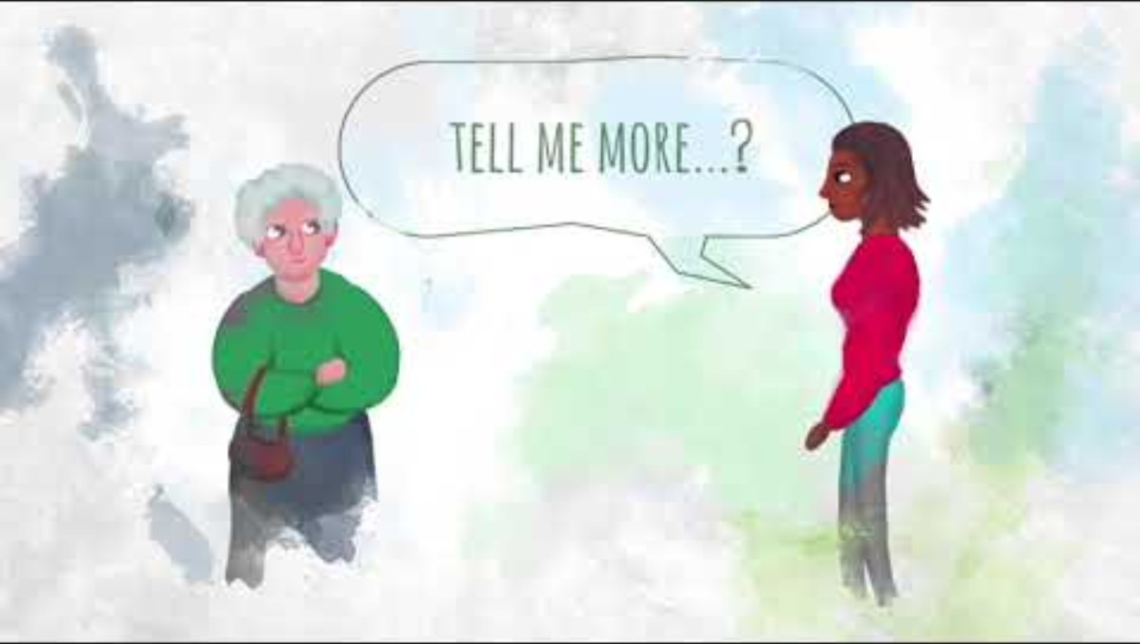
Suicide / Risk Video
Notes:
YouTube: Ask, Tell Have a Healthy Conversation https://www.youtube.com/watch?v=kGlQ_ePWw28&t=1s
Observe the tone: direct, calm, non-escalatory questioning
Notice how asking about suicide does not increase risk
Hold for Michael: you still act even without certainty

Slide 55
Risk decisions in practice
Balance autonomy with duty of care; escalate when risk becomes active against defined criteria.
Supervision supports proportionate decisions; records show questions, answers, and rationale.
Clear documentation protects clients and practitioners when events are later disputed.
Notes:
• Timing — Pre-Michael teaching: ~10–12 min including ~5 min less open discussion than v4.4; next slide is lived-experience video (~10 min) then Michael.
• NHS and social care thresholds are not identical to counselling thresholds; know your employer’s policy.
• Duty to warn or protect varies by jurisdiction; training curricula should name local law.

Slide 56
Case Study: "Michael"
Notes:
• Timing — Michael (Day 2 PM): ~50–55 minutes after the pre-case video for case slides, both task slides, hold uncertainty while acting, supervision, and integration discussion.
• Full narrative and tasks: V4-Michael-Risk.docx in the CASE STUDIES folder.
• Foci: ambiguous risk below crisis thresholds, contradictory hope cues, private-sector context, hold uncertainty while acting.
• Reasonable clinicians may disagree on escalation timing; accountable reasoning is the learning target.

Slide 57
Michael — function, contradiction, private context
He missed his last scheduled session, later explaining he had 'lost track of the day,' which fits with his account but adds to the pattern of inconsistency.
Sleep fragments between waking at 3 a.m. and sleeping past midday; eating is patchy; unintended weight loss; hygiene slips on bad weeks.
He works from home on a thin contract; daytime isolation is almost total; no occupational health route.
NHS talking therapies use stepped-care thresholds; private counselling may sit outside those pathways while concern remains real.
Sister offered joint session; he refuses, then says maybe later, and does not follow up—another ambivalent data point.
Notes:
• A no-show explained as losing the day may reflect cognitive slip in low mood, passive resistance, or both; it widens the file without confirming intent.
• Contradictory future orientation versus withdrawal is not intent to die; it is ambiguity that competent clinicians read differently.
• Functional markers anchor risk review when words minimise distress.

Slide 58
Michael — judgement without certainty
Practitioner unease sits below emergency-service thresholds yet above comfort with simple reassurance.
Autonomy supports continuing exploratory work; duty of care questions whether minimisation is being colluded with.
Insisting on GP contact now might rupture therapy; deferring might leave medical risk unassessed.
Two clinicians could disagree on timing; you still choose an action before the session ends and record unknowns explicitly.
Notes:
• Documentation separates observed behaviour, client words, and clinician inference—each line carries different evidential weight.
• Supervision unpacks whether your anxiety is calibrated to his data or to your own history with loss.

Slide 59
Tasks — Michael (1)
Formulation under uncertainty: integrate bereavement, withdrawal, functional change, and the contradictory future hint—stating what supports lower immediate risk and what keeps escalation on the table.
Immediate clinical decision: act now (for example insist on GP contact or boundary shift) or hold and contract—and what would flip your choice overnight?
If key information appears to be missing, make reasonable clinical assumptions and proceed.
Work with incomplete and contradictory information.
Notes:
• Timing — Michael tasks: ~25–30 minutes pair/small-group work across both task slides within the post-video Michael segment.
• Overnight flips often involve new intent, substance use, sudden isolation loss, or third-party report of plan.
• Private clients still merit NHS medical assessment when physical decline or severe depression is suspected.

Slide 60
Tasks — Michael (2)
Longer-term plan and/or supervision reflection: outline use of the next four sessions if he continues, and one supervision question separating your anxiety from his data.
Work with incomplete and contradictory information.
Notes:
• Four-session arcs might pair behavioural activation with grief processing if risk stays stable.
• Supervision questions on countertransference reduce false certainty in either direction.

Slide 61
Hold uncertainty while acting
Uncertainty does not remove duty to decide: you choose outreach level, frequency, documentation, and consultation on incomplete data.
Acting can mean a safety plan, GP encouragement, or family contact with consent—not only emergency services.
Waiting with a clear review date differs from passive drift; both should be explicit in notes.
Notes:
• Timing — Within Michael block: allow time after tasks for explicit discussion of acting versus waiting with incomplete files.
• Michael’s file illustrates that reasonable disagreement between clinicians is compatible with accountable individual decisions.
• Ethical tension stays live; closure narratives are avoided.

Slide 62
Supervision as containment
Supervision holds uncertainty that cannot be fully processed in the hour with the client.
It supports proportionate risk decisions and challenges both rescue and avoidance pulls.
It is a professional requirement in most UK training and practice frameworks, not an optional extra when anxious.
Notes:
• Timing — Day 2 PM: supervision material supports the final integration and closing; leave ~15–20 minutes for integration + closing + references if the day ends at 17:00.
• Group and individual supervision differ in confidentiality; bring anonymised facts consistent with your service policy.
• Supervision minutes can be subpoenaed in some proceedings; content should stay factual and proportionate.

Slide 63
Integration
Hold meaning and risk together across the weekend’s cases without collapsing into either pure pathology or pure optimism.
Recognise limits of the counselling role relative to medicine, statutory services, and employer duties.
Decision-making, documentation, and supervision together form ethical practice—not intuition alone.
Notes:
• Timing — Pre-closing: integration often runs 10–15 minutes depending on discussion length.
• Integration links Leah’s shame, Ousmane’s overload, Emily’s dissociation, and Michael’s ambiguity under one risk–formulation framework.
• Psychosynthesis contributions sit alongside safeguarding law and NHS interfaces.

Slide 64
Selected references
Nelson, J.E. (1994) Healing the split: Integrating spirit into our understanding of the mentally ill. Albany, NY: State University of New York Press.
Firman, J. and Gila, A. (2002) Psychosynthesis: A psychology of the spirit. Albany, NY: State University of New York Press.
Firman, J. and Gila, A. (1997) The primal wound: A transpersonal view of trauma, addiction, and growth. Albany, NY: State University of New York Press.
Grof, S. and Grof, C. (eds) (1989) Spiritual emergency: When personal transformation becomes a crisis. [Publication details to confirm.]
Clarke, I. (ed.) (2001) Psychosis and spirituality: Exploring the new frontier. [Publication details to confirm.]
Clarke, I. (ed.) (2010) Psychosis and spirituality: Consolidating the new paradigm. [Publication details to confirm.]
Notes:
• Timing — Final slide: references can be emailed or posted rather than read aloud if time has overrun.
• First three references are complete as printed; match your programme’s Harvard punctuation if required.
• Grof and Clarke entries lack publisher and place in this master list; confirm in library catalogues before formal essays.
• Critical medicalisation literature may be taught separately; only cite with full bibliographic data.

